Slide 1
Management Styles
Dr. Satarupa Roychowdhury
SOMS, IIESTS

Slide 2
Management Styles
A Leader is one who guides and directs other people. He gives the efforts of his followers a direction and purpose by influencing their behaviour. And the quality of the behaviour of individuals whereby they guide people or their activities in organizing efforts.
The behavioural pattern which a leader exhibits in getting things done through others is known as his style of leadership. The leadership style in a particular situation is determined by the leader’s personality, experience and value system, type of followers, and nature of the environment. There are three important leadership styles which are based on the use of authority. These are:
Autocratic or authoritative leadership
Participative or democratic leadership; and
Free rein or laissez-faire leadership.

Slide 3
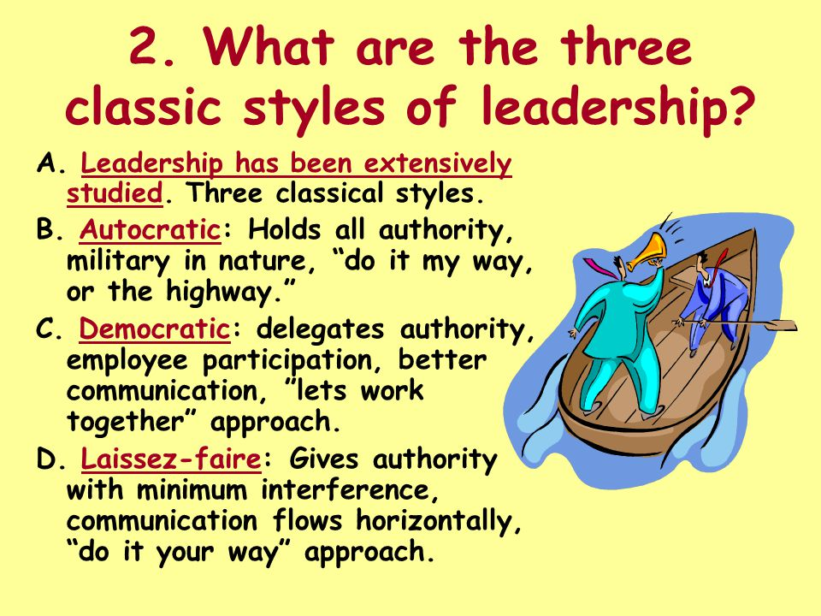

Slide 4
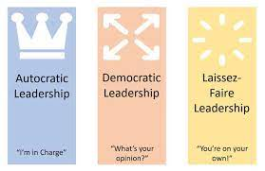

Slide 5
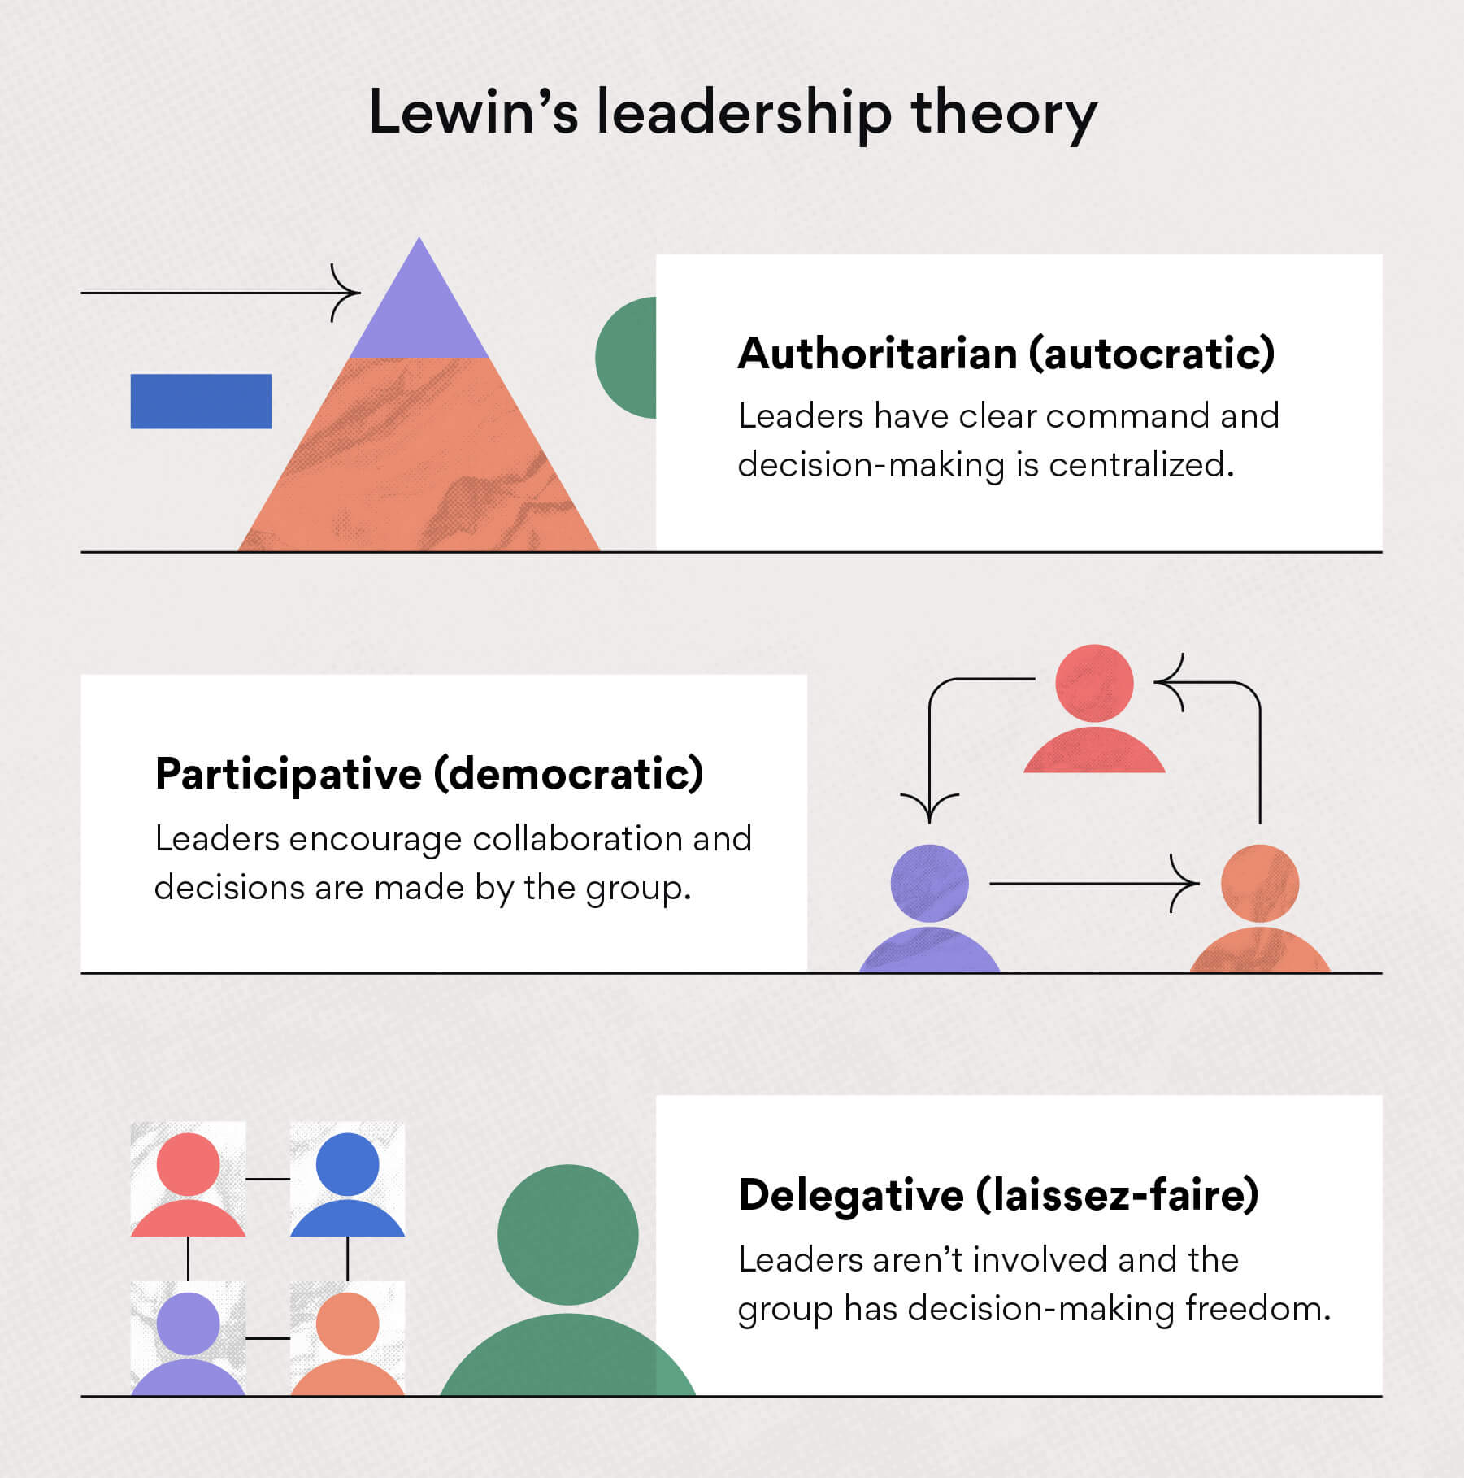

Slide 6
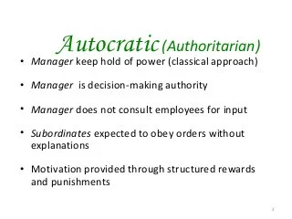

Slide 7
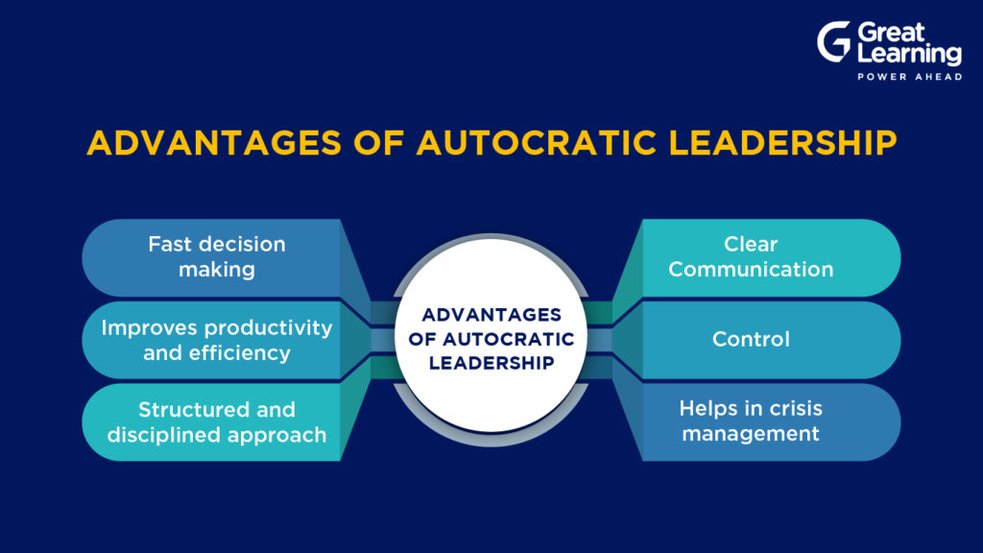

Slide 8
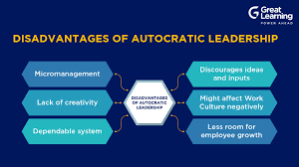

Slide 9
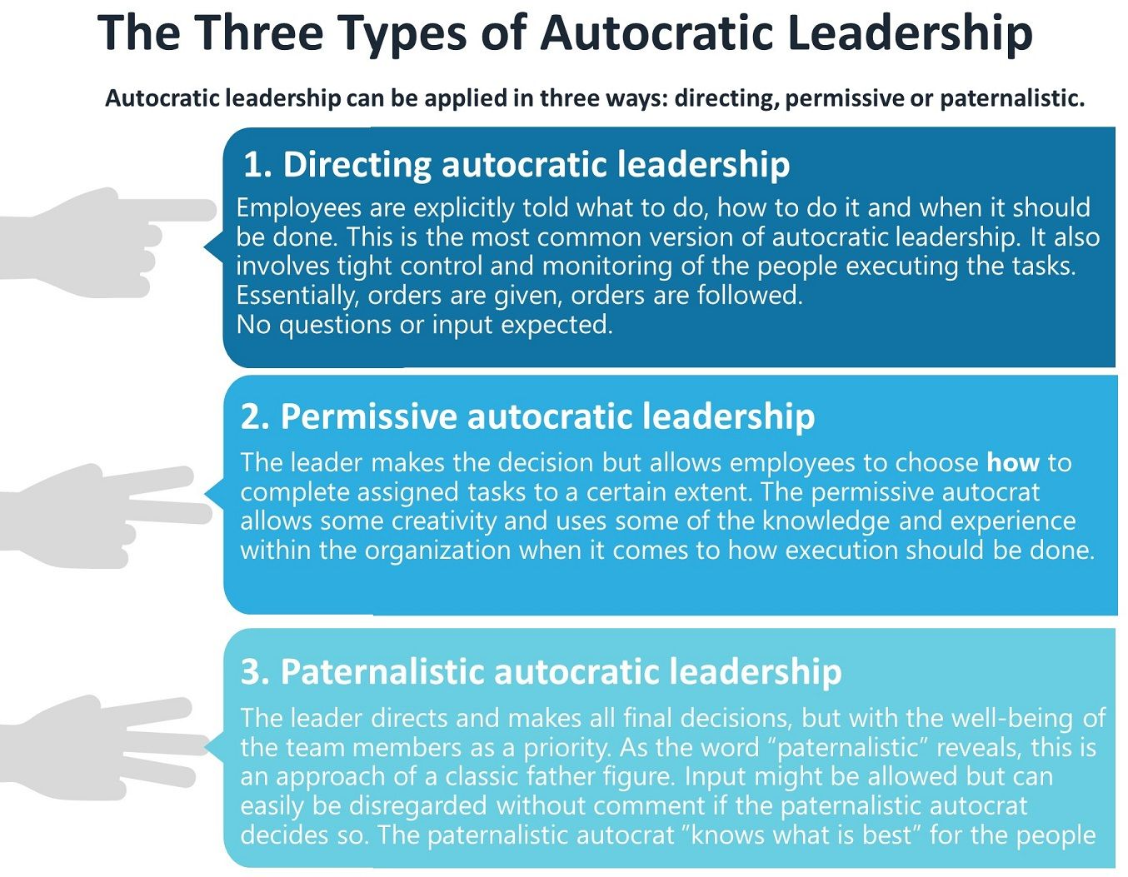

Slide 10
Situations Favouring Autocratic Leadership
When fast action is needed
When leader is clearly the expert
When the big picture is needed
When focus is under threat

Slide 11
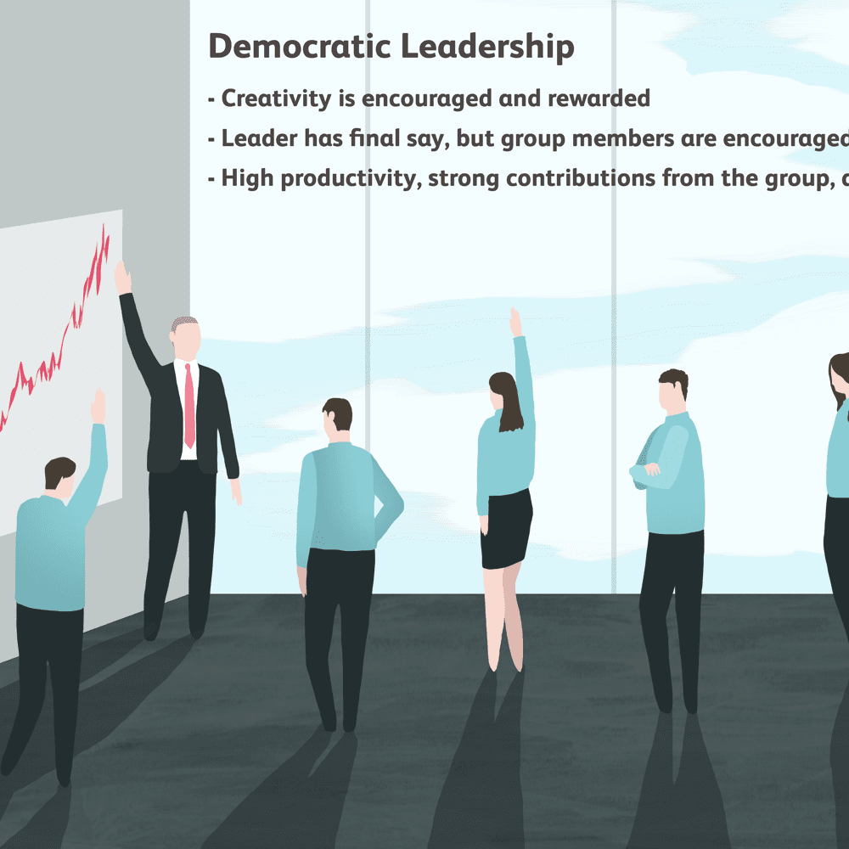
Democratic Leadership

Slide 12
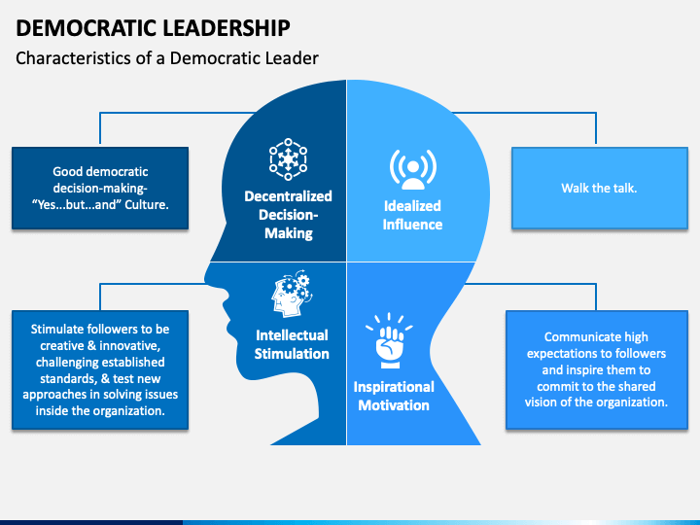

Slide 13
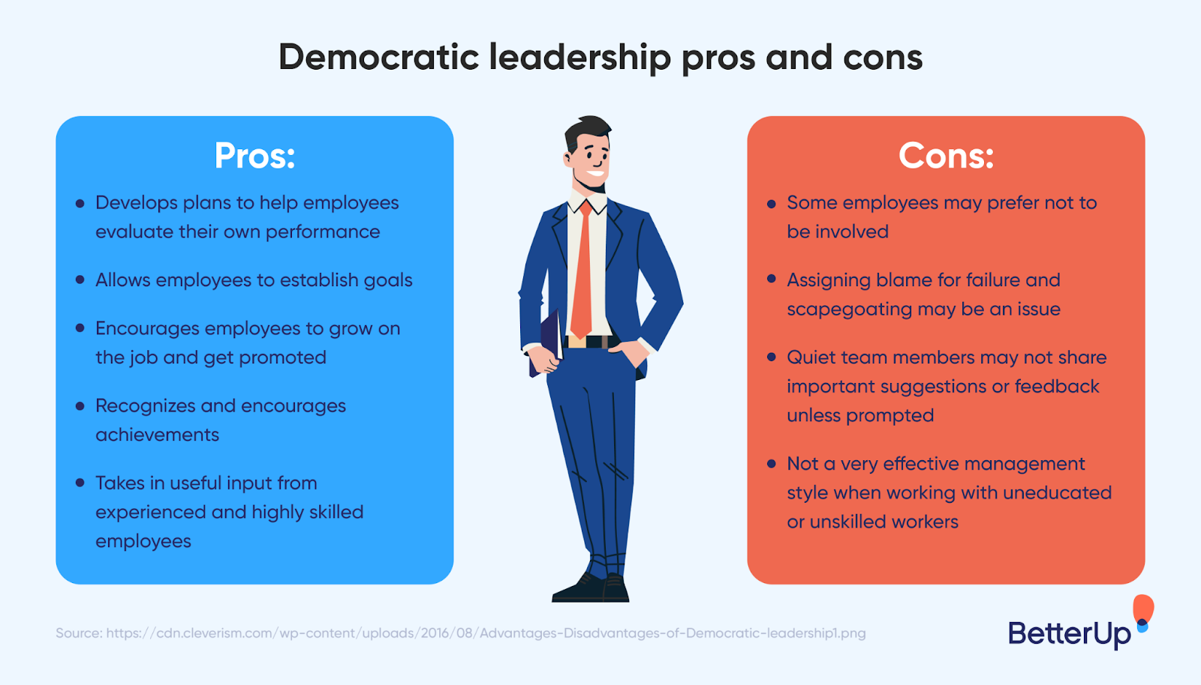

Slide 14
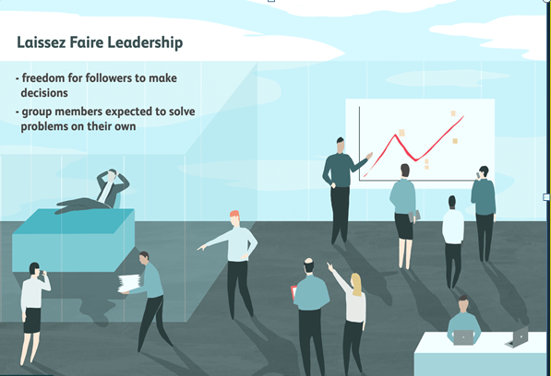

Slide 15
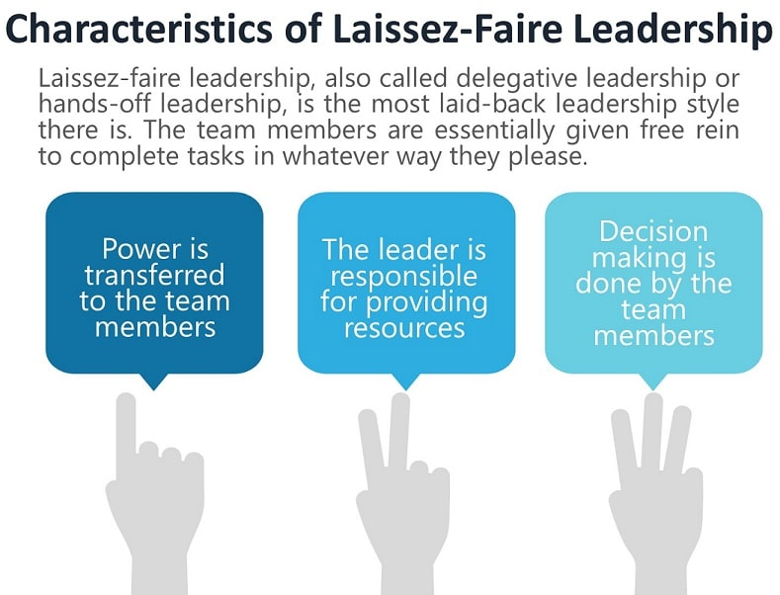

Slide 16
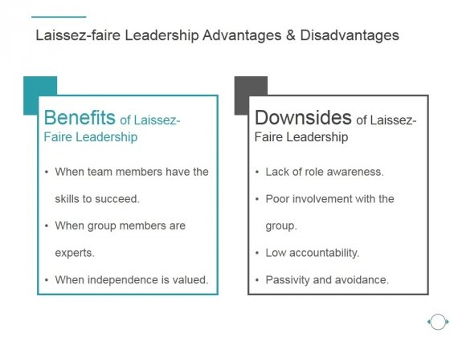

Slide 17
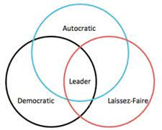

Slide 18
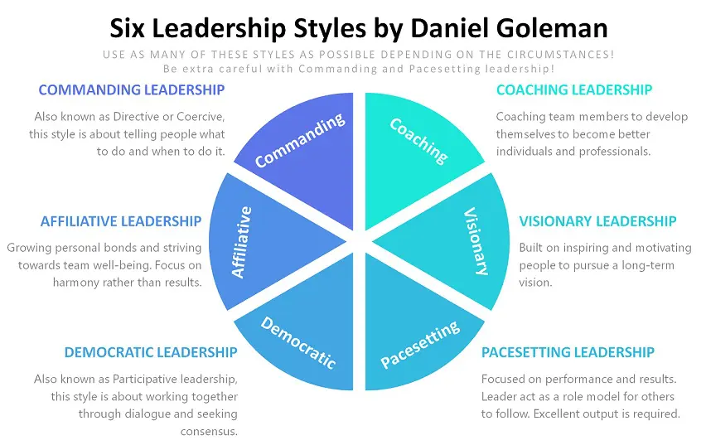

Slide 19
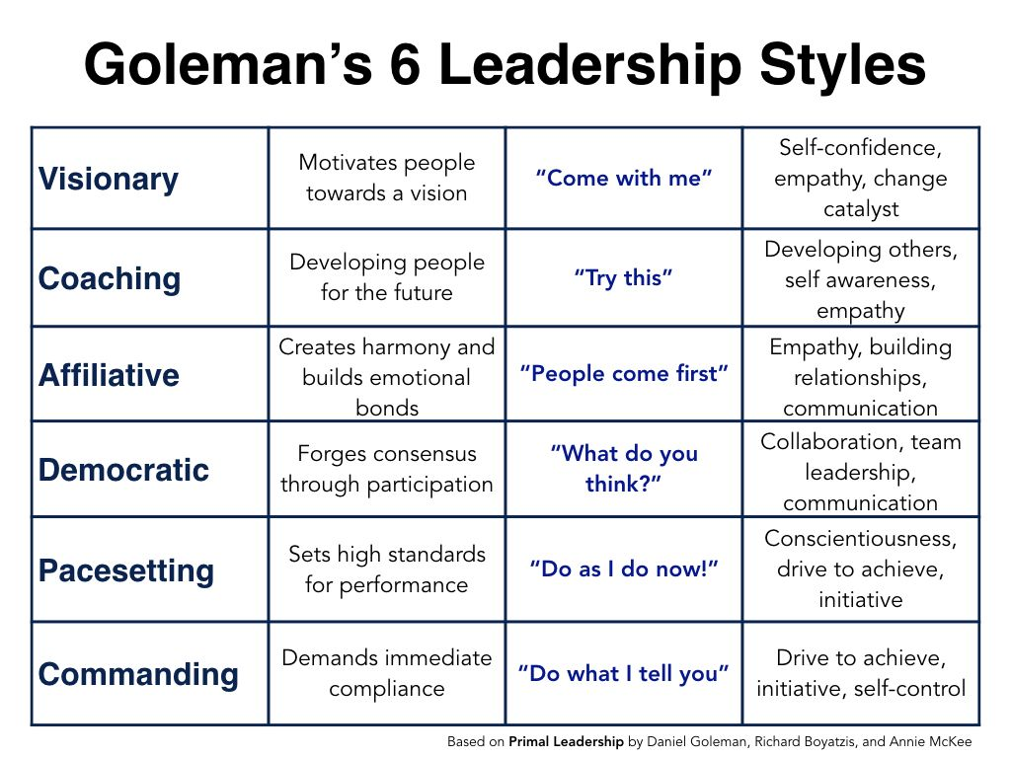

Slide 20
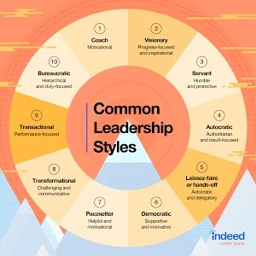

Slide 21
Situational Leadership Style
A Situational Leader employs one of four leadership styles that provide him or her with the highest probability of success in every situation they encounter. Those situations are a function of the task that needs to be performed, in conjunction with the task-related ability and willingness of the follower identified to perform it. Based on the objective assessment of those parameters, and with the responsibility of successfully and effectively influencing the follower, the leader responds to the situation with one of four leadership styles. Those styles are operationally defined by Task/Directive Behavior and Relationship/Supportive Behavior:

Slide 22
Task/Directive Behavior – the extent to which the leader tells the follower what to do, how to do it, where it needs to be done and when it needs to be completed
Relationship/Supportive Behavior – the extent to which the leader engages in open dialog with the follower, actively listens and provides recognition/reinforcement for task-related progress

Slide 23
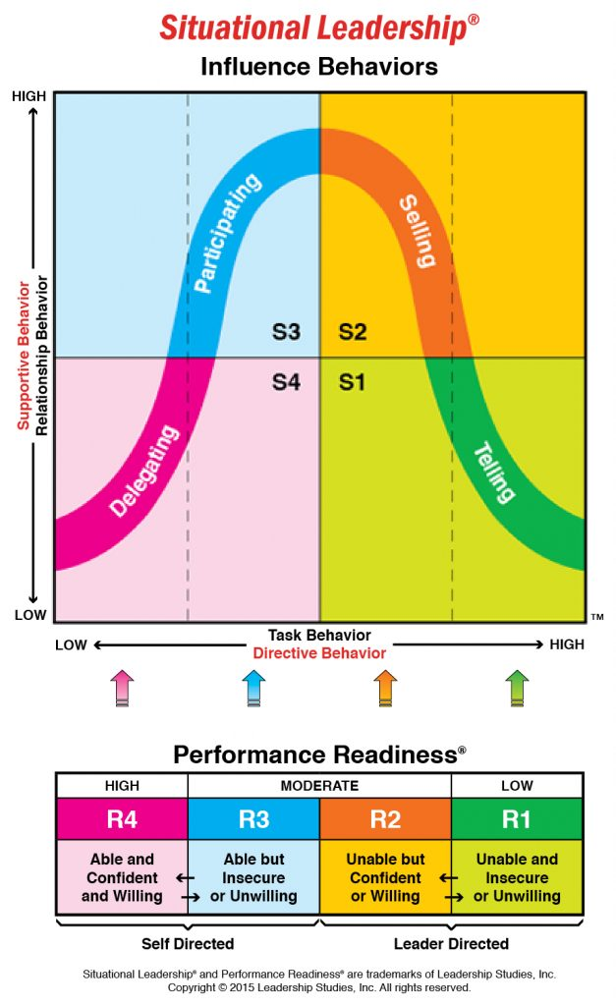

Slide 24
STYLE 1– TELLING, DIRECTING or GUIDING
Style 1 or a telling leadership style, is characterized by the leader using moderate to high amounts of Task Behavior and moderate to low amounts of Relationship Behavior. The leader makes decisions surrounding the timely completion of the task and provides the follower with the benefit of his/her experience in that regard. The flow of communication is from the leader to the follower. Questions posed by the leader are typically focused on clarity (.e.g. “Do you have any questions on the instructions we’ve just reviewed?”).
Style 1 is a short-term approach intended to create movement. It aligns with followers who have limited (if any) experience or skill performing the task in question and (for whatever reason) are either insecure or unmotivated to try. Style 1 requires close supervision by the leader for the express purpose of identifying any signs of incremental progress (to be recognized by the leader in an effort to accelerate ongoing development).

Slide 25
STYLE 2 – SELLING, COACHING or EXPLAINING
Style 2 or a selling leadership style, describes a leadership approach that is high on both Task and Relationship Behavior. The leader still maintains decision rights regarding what the follower needs to be doing, how they should be doing it and when it needs to be completed, but that structure is provided in combination with ample opportunity for discussion of why the task is important and where it fits into the overall scheme of operation. The leader also actively recognizes the enthusiasm, interest and commitment of the follower for learning and gaining task-related experience.
Style 2 is intended to create buy-in and understanding. It aligns with followers who have limited (if any) experience performing the task but exude both confidence and motivation toward the process of leader-driven skill development. Like Style 1, effective use of this approach depends upon direct observations by the leader, which fuel focused performance feedback discussions and increased dialog.

Slide 26
STYLE 3 – PARTICIPATING, FACILITATING or COLLABORATING
Style 3 or a participating leadership style, is fundamentally different from Styles 1 and 2 in that it is “follower driven” as opposed to “leader driven.” As such, it depicts an approach that is high on Relationship Behavior but low on Task Behavior. In that context (and from the leader’s perspective), the follower has the ability to perform the task in question at a sustained and acceptable level but lacks either the confidence or the motivation/commitment to do so.
The objective of Style 3 is to create alignment. If the follower is developing, he/she might have demonstrated task proficiency but still have some degree of trepidation about performing it on their own. If the follower is regressing, they are aware they can effectively perform but have lost commitment, motivation (or both) to do so. Either way, the leader needs to discuss the follower’s willingness by asking open-ended questions intended to help the follower recognize the source of the performance challenge and generate a viable solution.

Slide 27
STYLE 4 – DELEGATING, EMPOWERING or MONITORING
Style 4 or a delegating leadership style, is another “follower-driven” leadership approach that is characterized by low amounts of both Task and Relationship Behavior. The follower can perform the task at a sustained and acceptable level and is both confident and motivated to do so.
The intent of Style 4 is to create/enhance task mastery and autonomy. It aligns with followers that have significant experience performing the task at or above expectation, in combination with a level of intrinsic motivation that drives their ongoing commitment to excellence. The flow of communication with Style 4 is from the follower to the leader and is typically initiated by questions from the leader that feature significant degrees of freedom (e.g. “From your perspective, what is working and what do we need to consider doing differently moving forward?”).
Based on your own experience as a leader (and as a follower), consider that the most inconsistent thing a leader can do is to treat everybody the same. A leader’s approach should be dictated by the nuances of each situation they encounter. Situational Leadership is a practical, repeatable model that helps leaders do just that!

Slide 28
Transactional Leadership Style
Transactional leadership or transactional management is the part of one style of leadership that focuses on supervision, organization, and performance; it is an integral part of the Full Range Leadership Model. This type of management was born during the Industrial Revolution as a source of competitive advantage. Some typical tactics of this type of management include strategy, efficiency goals, economies of scale and quality differentiation. Transactional managers focus on performance related tasks and goals.
Transactional leadership is a style of leadership in which leaders promote compliance by followers through both rewards and punishments. Through a rewards and punishments system, transactional leaders are able to keep followers motivated for the short-term.

Slide 29
Transactional leadership works well in organizations where structure is important. Transactional leadership is not the right fit for organizations where initiative is encouraged:
Transactional leadership pros:
Rewards those who are motivated by self-interest to follow instructions
Provides an unambiguous structure for large organizations, systems requiring repetitive tasks and infinitely reproducible environments
Achieves short-term goals quickly
Rewards and penalties are clearly defined for workers
Transactional leadership cons:
Rewards the worker on a practical level only, such as money or perks
Creativity is limited since the goals and objectives are already set
Does not reward personal initiative

Slide 30
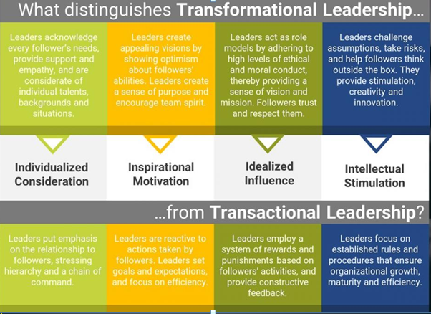

Slide 31
